Slide 1
Class Diagrams
Class Structure
  From Sequence Diagrams to Class Diagrams
Class Relationships
  Association
  Aggregation and Composition
  Generalisation (Inheritance)
From Class Diagrams to Code
©Paul Davies 2020. Not to be copied, used, or revised without explicit written permission from the copyright owner. This lecture may contain animations and is best viewed as a slide show

Slide 2
Identifying Class Structure
Once sequence diagrams have been drawn to capture the behaviour of our system use-cases, we next attempt to capture the static structure or architecture of our software in the form of a ‘class diagram’.
This is an attempt to Identify
  The Classes from which our objects (identified on the sequence diagram) will be constructed.
  The Member Functions of those classes (mapped from the messages sent to objects in the sequence diagram).
  The Member Variables/items of data that the objects will need in their classes.
  The Relationships between objects so that message passing can be implemented.
Example YouTube Video on Class Diagrams
https://www.youtube.com/watch?v=UI6lqHOVHic

Slide 3
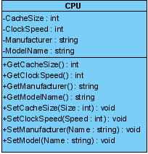
A class diagram is important because it gives our developers an overview of the header and source files that have to be created, the member functions and variables, and the relationships between classes.
An illustration of a single UML class is shown below. It is split into three compartments: Class Name, Member Variables and Member Functions.
https://www.visual-paradigm.com/support/documents/vpuserguide/94/2576/7190_drawingclass.html
Right mouse click on a class to add attributes or functions (i.e. member variables/functions) in V.Paradigm
Type of variable is ‘string’
Class Name is ‘CPU’
Class CPU has 4 member variables
Member Variables (display optional)
Class CPU has 8 member functions
Member Functions (display optional)
Return type of function SetManufacturer() is ‘void’
Accessibility Indicator:
‘+’ means public
‘-’ means private
‘#’ means protected
Function SetModel() takes 1 parameter (name) of type ‘string’

Slide 4
How do we Identify the Classes?
Starting with your sequence diagrams, identify each object in turn.
Create a new class to represent each different type of object. Objects of the same type e.g. 4 elevators could be represented by the same class on a class diagram. For example 4 elevators are simply “instances” of a single class.
How do we Identify the Member Functions within each Class?
Look at the messages that are sent TO objects on your sequence diagram:
  Each of those messages ultimately map directly to a member function within the class which implements that object. For example, a sequence diagram that shows a Switch sending an “on” or “off” message to a Bulb, means that the bulb class will have functions “on()” and “off()” to deal with those message.
  The parameters of the message (data sent as part of the message) map directly to the parameters in that member function. For example a cruise controller sent the message setspeed “70” will have a like this
  e.g. setspeed (int speed)
  Any results/data returned by the messages in the sequence diagram map directly to the data returned or generated by the member function.

Slide 5
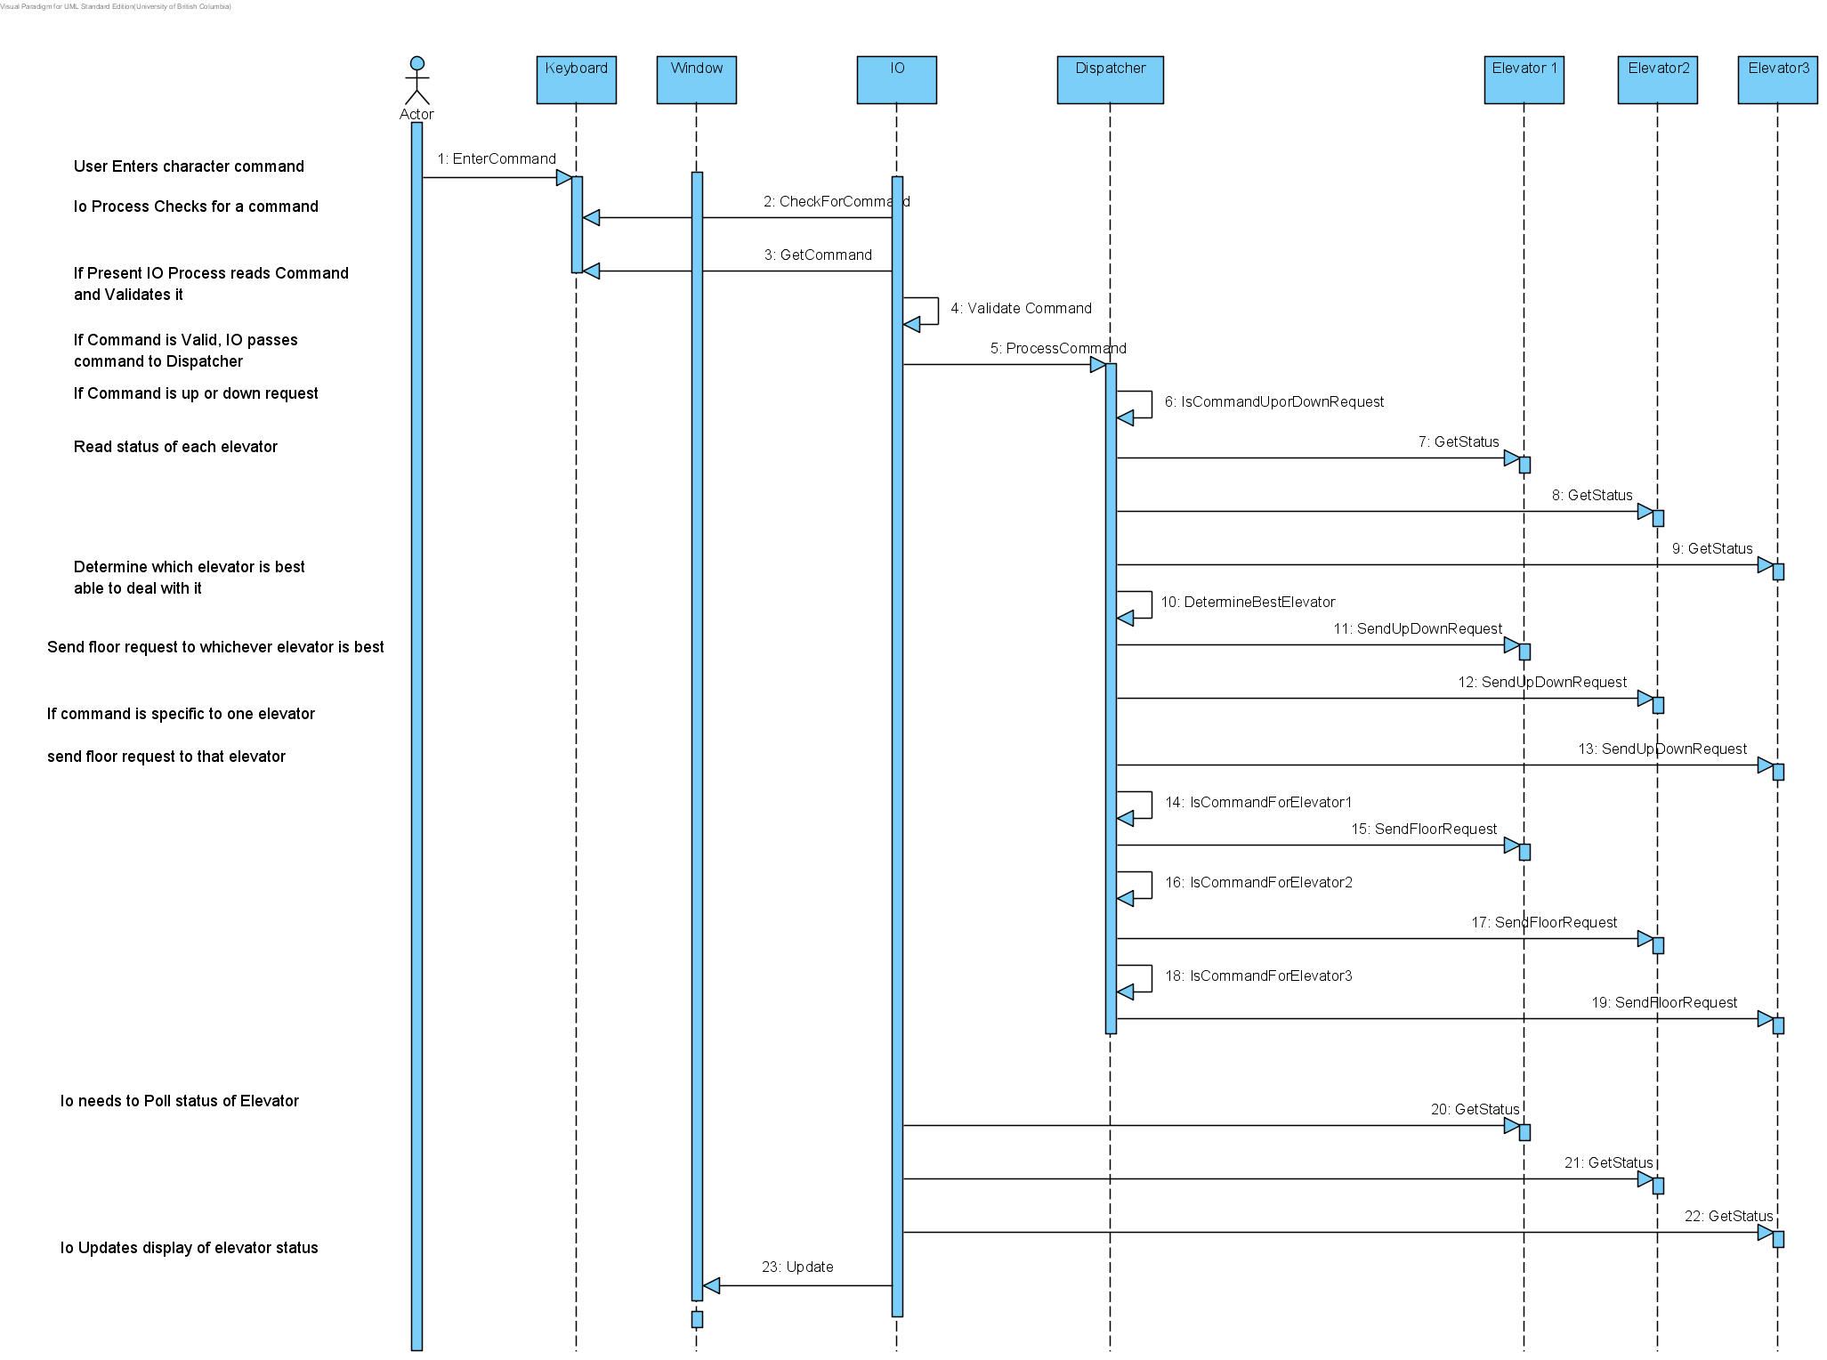
Exercise: Map this Sequence Diagram to a class diagram. Identify the member functions, arguments and returned data (don’t worry about capturing member variables or relationships, they are uncovered later)

Slide 6
Identifying and capturing relationships on a class diagram

Slide 7
UML Class Relationships
Once you have identified and placed all your classes on your class diagram, you can begin to identify and capture any important or significant relationships between them.
The UML provides three important types of class relationships.
  Association.
  Encapsulation in the form of
    Aggregation.
    Composition.
  Generalization.

Slide 8
Association Relationships
Association: Whenever one object sends a message to another object on our sequne diagram, there is an implied association (i.e. a using or working relationship) between the classes that represent those objects.
Associations between classes exist to allow one object of that class to gain access to the services of another e.g. to send messages. For example
An ‘Engine’ and the ‘ECU’ in a vehicle.
A floor request button and the Elevator controller.
A light switch and a bulb
Association relationships are easy to identify from the sequence diagram by looking at which objects send messages to other objects
We capture the message passing that occurs between those objects in the form of an association between the classes that implement those objects.

Slide 9
Exercise: Identify associations from this sequence diagram. If an object sends a message to another, then there is an association relationship between the classes representing sender and receiver objects.

Slide 10
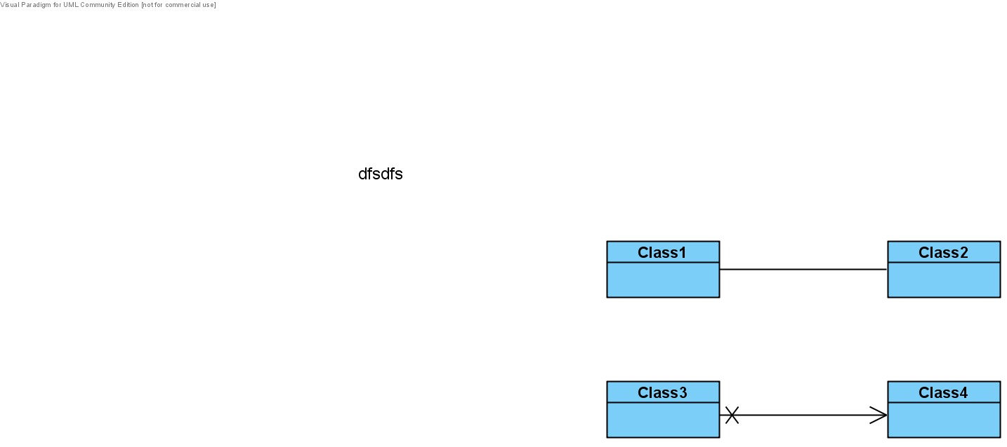
Capturing Associations on a Class Diagram
Two examples of an association between classes is shown below
(Note: details of member variables and functions have been omitted for clarity)
Bi-directional association. Objects of Class1 are able to send messages to Objects of Class2 and vice-versa. Note no arrows on the association.
Uni-directional association. Objects of Class3 are able to send messages to Objects of Class4 but not the other way around
Note: To create a Uni-directional association in V.Paradigm, draw a bi-directional one first, then 'right-mouse-click' on one or other end of the association and select 'Navigable and set to true or false'

Slide 11
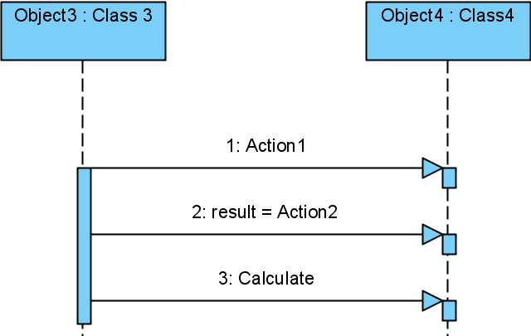
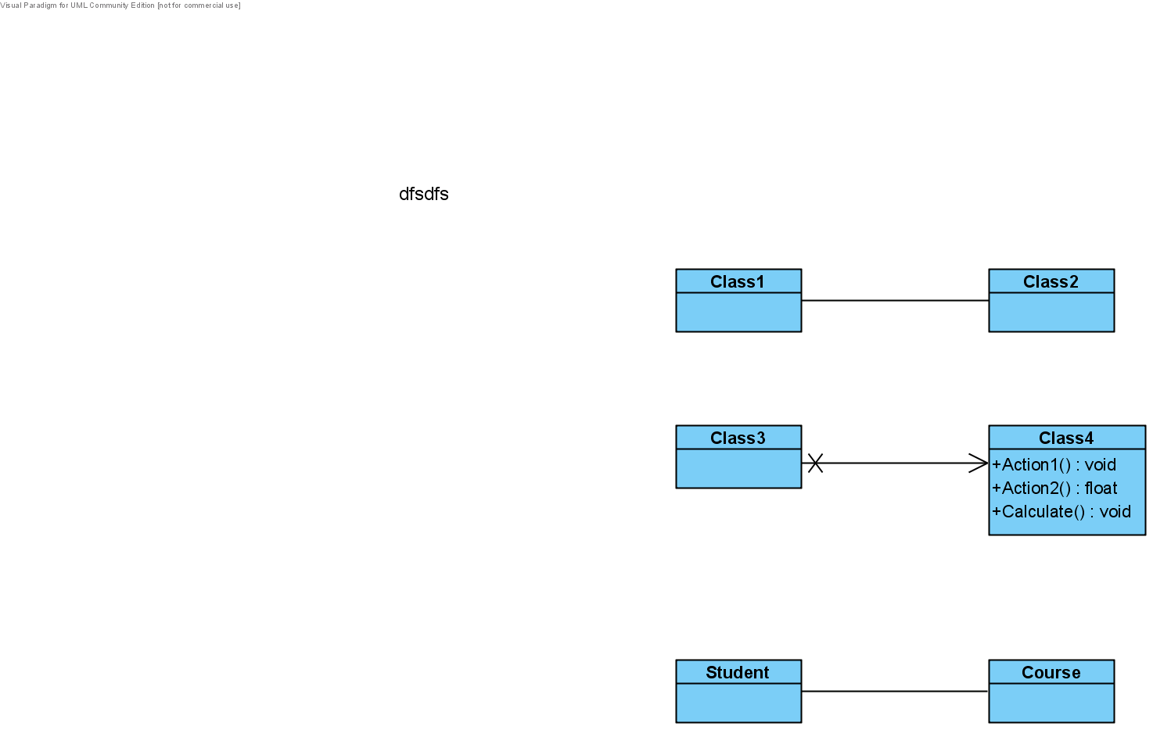
Example Mapping of a Sequence Diagram to a Class Diagram
In the example below, messages are sent in one direction: from Object3 to Object4, this implies a uni-directional association in the class diagram.
Note: An object returning data in response to a message sent to it (as in message 2 below) does not imply the existence of bi-directional messaging.
Note mapping of messages to Functions
Section from a Sequence Diagram
Maps to this on a Class Diagram
Uni-directional Association
Object3 (represented by Class 3) sends a variety of messages to Object4 (i.e. Class 4) but not the other way around, implying a uni-directional association on the class diagram.

Slide 12
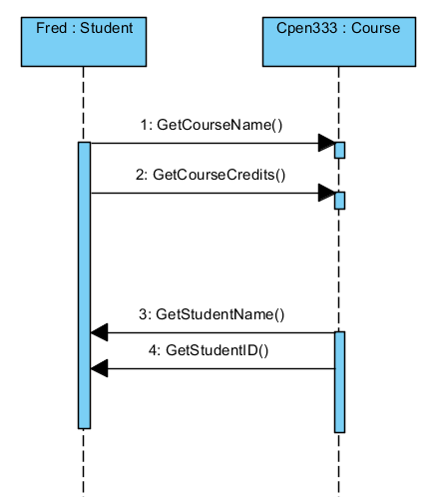
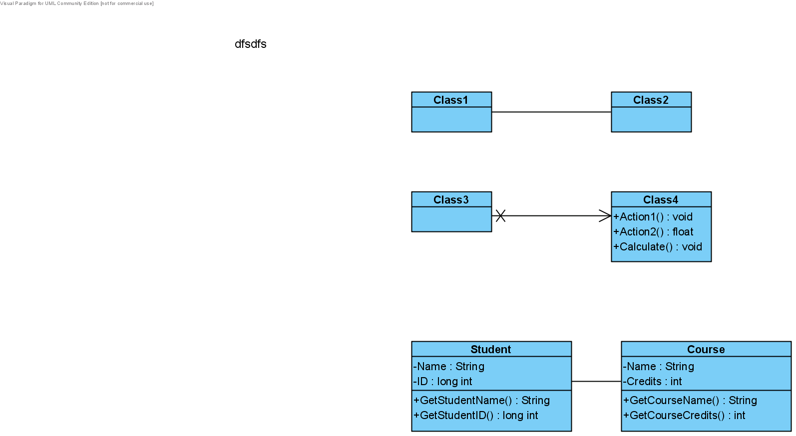
Another Example: A sequence diagram showing 1 student interacting with 1 course
Section from a Sequence Diagram
Maps to this Class Diagram
Bi-directional Association
Note mapping of messages and implied member variables in both classes
‘Fred’ (a ‘Student’) sends messages to ‘Cpen333’ (a ‘Course’) and vice-versa, this implies a bi-directional association on the class diagram.

Slide 13
What does an Association mean from a code perspective?
An association relationship implies that instances of one class can send messages (or navigate) to instances of the other class and thus should maintain a pointer to that destination class within it.
The pointer can be used with the ‘->’ operator to send messages to, or invoke member functions within the object hanging off, the end of the pointer.
For example, from the previous class diagram, the code implementation of the class ‘Student’ might have a pointer like this:
  class Student {
  Course *theCourse ; // Each Student object will have a pointer to a Course Object
  . . . // The pointer can be used to send messages to the student’s 1 course.
  // The pointer needs initialisation at run time o point to its course
  } ;
Class ‘Course’, would look like this (due to the bi-directional relationship between instances of these two classes).
  class Course {
  Student *theStudent ; // Each Course object will have a pointer to a Student Object
  . . . // The pointer can be used to send messages to the course’s 1 student.
  } ;

Slide 14
Of course code will be needed to initialise and maintain these pointers at run time.
For example, we could add the implied functions AddCourse() and AddStudent() and make sure they are called after the objects “fred” and “CPEN333” have been created.
Only one Add() function need be called (either one) to establish the bi-directional relationship.
  class Student {
  public: Course *theCourse ; // pointer to an instance of a Course object
  void AddCourse( Course *aCourse) // Fn to create a relationship to a Course object
  {
  theCourse = aCourse ; // point to the Course object for this student
  theCourse -> theStudent = this ; // IMPORTANT: Make sure that course
  } // points back to me as association is bi-directional
  } ;
  class Course {
  public: Student *theStudent ; // pointer to an instance of a Student object
  void AddStudent (Student *aStudent) // add a Student object to a Course
  {
  theStudent = aStudent ; // point to the Student object for this Course
  theStudent -> theCourse = this ; // IMPORTANT: Make sure that student
  } // points back to me as association is bi-directional
  } ;
Pass a pointer to the Course object
Pass a pointer to the Course object
Pass a pointer to the Student object
Pass a pointer to the Course object

Slide 15
We could set up the associations at run time using code like this
  main()
  {
  Student Fred ; // create an instance of a student called Fred
  Course Cpen333 ; // create an instance of a course
  Fred . AddCourse( &Cpen333 ) ; // point Fred to course Cpen333 and vice-versa
  // Fred and Cpen333 can now send messages
  } ;
Or, from the other end of the relationship we could do this instead, but there is no need to do both, as either Add() function sets up the bi-directional link so that the objects point to each other.
  main()
  {
  Student Fred ; // create an instance of a student called Fred
  Course Cpen333 ; // create an instance of a course
  Cpen333 . AddStudent( &Fred ) ; // point Cpen333 to student Fred and vice-versa
  // Fred and Cpen333 can now send messages
  } ;

Slide 16
  class Student {
  Course *theCourse ;
  AddCourse( Course *aCourse)
  {
  theCourse = aCourse ;
  theCourse -> theStudent = this ;
  }
  } ;
  class Course {
  Student *theStudent ;
  AddStudent( Student *aStudent)
  {
  theStudent = aStudent ;
  theStudent -> theCourse = this ;
  }
  } ;
Cpen3333's student pointer Points to Fred
Student Fred
Course Cpen333
  Course *theCourse ;
  Student *theStudent ;
Fred's course pointer points to Cpen333
  main()
  {
  Student Fred ;
  Course Cpen333;
  Fred . AddCourse(&Cpen333)
  . . .
  }
Fred can now send messages to Cpen333 and
Cpen333 can send messages to Fred

Slide 17
Of course if you “break” an association at run time, (perhaps because a object at one end has been destroyed) you have to set the pointers in both classes to NULL (invalid) to show that they no longer link those objects together.
  class Student {
  public: Course *theCourse ; // pointer to an instance of a Course object
  void DropCourse( ) // Fn to destroy a relationship to a Course object
  {
  if(theCourse != NULL) { // make sure we are pointing to a course first
  theCourse -> theStudent = NULL ; // Break link in Course pointing back to me
  theCourse = NULL ; // Break link from me (Student) to Course object
  }
  }
  } ;
  class Course {
  public: Student *theStudent ; // pointer to an instance of a Student object
  void UnEnroleStudent () // Fn to destroy a relationship to a student object
  {
  if(theStudent != NULL) { // make sure we are pointing to a student first
  theStudent -> theCourse = NULL ; // Break link in Student pointing back to me
  theStudent = NULL ; // Break link from me (Course) to Student object
  }
  }
  } ;

Slide 18
How do we send a message from one object to the other object at the end of our relationship? Use the relationship/association pointer
class Student {
public: Course *theCourse ; // the pointer to the student’s 1 course
…..
void PrintCourseDetails() { // prints details of the student’s 1 course
// the following ‘if’ test is required because we have to make sure that the student is pointing to his/her
// courses, i.e. that there is a valid course object at the end of the association
if( theCourse != NULL) {
cout << "I am Taking Course : " << theCourse -> GetCourseName() << endl ;
cout << "The Credit Value is " << theCourse -> GetCourseCredits() << endl ;
}
}
. . .
. . .
} ;
Now we could write in our application something like: Fred.PrintCourseDetails();
IMPORTANT run-time CHECK of validity of association, i.e.
to make sure the student has enrolled on a course
Use pointer in this ‘student’ object to send a message to the course object at the other end of this relationship

Slide 19
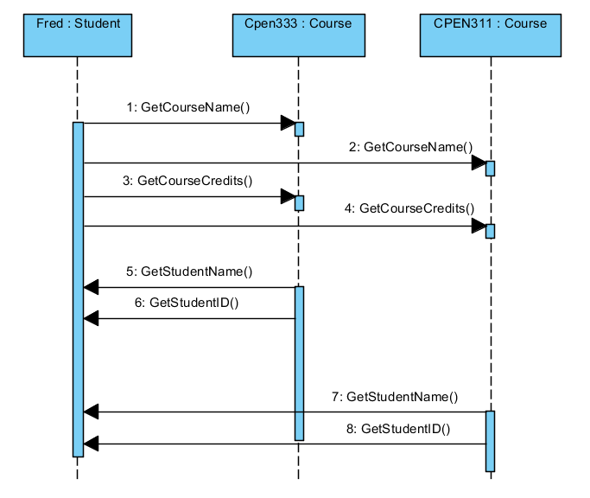
In this sequence diagram we see that student ‘Fred’ associates with (i.e. is enrolled) on two courses: Cpen333 and Cpen311, but each course only has 1 student.
How does this map to a class diagram?
Note Multiplicity set to ‘2’
Section from a Sequence Diagram
Maps to this Class Diagram
2
Student needs 1 pointer per course
class Student {
Course *course1 ; // points at runtime to Cpen333
Course *course2 ; // points at runtime to Cpen311
. . .
} ;
class Course {
Student *theStudent ; // points to ‘fred’ at runtime
. . .
} ;
Bi-Directional Message Passing

Slide 20
Association Multiplicity
This brings us to the more general topic of association multiplicity.
At design time (when we are drawing our class diagrams) we cannot always predict how many courses a student might ‘enrol on’ (associate with) or how many students enrol enrole on any particular course, the number will vary at run-time and hence the number of objects that may exist at the end of an association could also vary.
We refer to the number of objects at the end of a class association as its ‘multiplicity’ and it is defined for both ends of the association.
UML class diagrams can capture a variety of different multiplicities as summarised in the table below.
0..1 | Could be 0 or 1 objects (caution: could be 0 so run time check needed to make sure pointer association is initialised – see Page18).).
* | Unknown many (caution: could be 0 so run time check needed to make sure pointer association is initialised – see Page18).
n | Guaranteed always to be exactly ‘n’ objects (e.g. 5). No run time check needed for pointer initialisation
1..* | Unknown many but definitely at least 1. No run time check needed for pointer initialisation

Slide 21
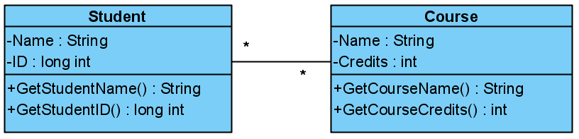
Capturing Multiplicity on a class Diagram
‘*’ indicates that a Course may be associated at run time with an unknown number of Students (could be 0)
*
*
‘*’ indicates that a Student may be associated at run time with an unknown number of Courses (could be 0)
To set multiplicity in V.Paradigm, 'right-mouse-click' on one end of the association and select 'Multiplicity'

Slide 22

Implementing Association Multiplicity
Multiplicity means that for each object that could exist at the end of the association, a unique pointer will be required.
A multiplicity of ‘0..1’ indicates that an object of class4 may not always be pointing to an object of class 3 at run time so you have to check
0..1
1
A multiplicity of ‘1’ indicates that an object of class3 object will always be pointing to exactly one object of class4 at run time (no check needed – in theory)

Slide 23

A multiplicity of exactly ‘5’ requires ‘5’ separate pointers (could use an array of 5 pointers)
An unknown multiplicity of ‘*’ means some form of dynamic data structure/container will
be required such as a list that can grow to accommodate an unknown number of objects.
Maintaining these associations, as far as adding a new object, removing an object at the end etc. is obviously more difficult than maintaining a single pointer to a single object.
However you chose to implement multiplicity, the UML states that there should be no duplication of objects at the end of each association. That is you cannot have two pointers pointing to the same object, or in real terms, a student cannot enrol on the same course twice. Therefore enrolling a student in a course should involve checking for duplicate enrollment first.
class Class1 {
Class2 *theClass2Objects[5];
} ;
class Class2 {
list<Class1 *> theClass1Objects;
} ;
Multiplicities with a ‘*’ mean the association will probably be implemented by a some kind of list.
Fixed multiplicities of say ‘5’ mean the association can be captured in Class 1 by an array of five ‘Class2’ pointers

Slide 24
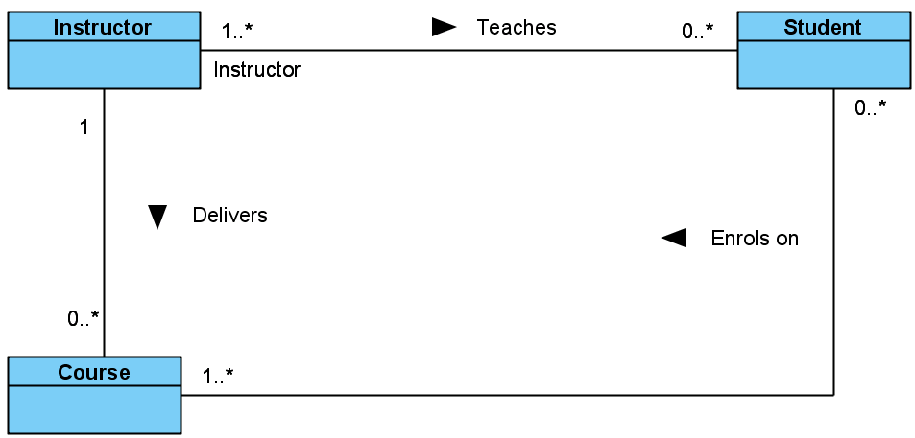
Association Names to aid Readability
Association name: Optional. Aids readability only, (no code is implied) and the optional arrow indicates direction of reading e.g. Instructor teaches Student
Instructor delivers Course
Student enrols on Course
The diagram above can be interpreted to mean
An Instructor teaches 0 or more Students. Each Student is taught by 1 or more Instructors.
An Instructor delivers 0 or more Courses. Each Course is delivered by exactly 1 Instructor.
A Course can be taken by 0 or more Students. Each Student enrols in 1 or more Courses.
To add an association name: double click on the association line and type the name. To add direction arrow, right mouse click on association line and select presentation options->show direction. Use Reverse Direction to set direction

Slide 25
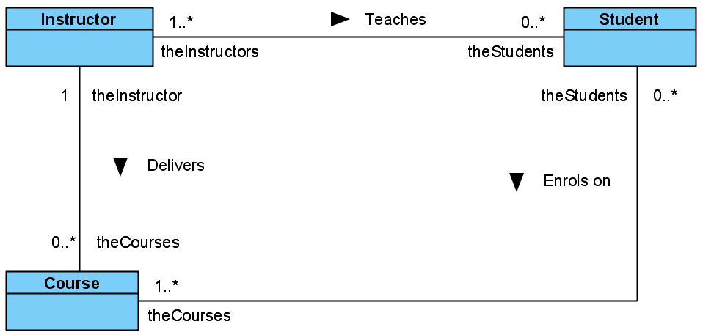
Role Names
Purpose: Can sometimes be used to help the reader with their understanding of the diagram. Some automated code generator tools may use the role name to fix the name of the pointer (or list of pointers) in the class at the other end of the association (see below).
Generally I leave them out unless it adds something of significance to the diagram but you may see them on other diagrams.
Class Instructor {
list< Student * > theStudents ;
list< Course * > theCourses;
} ;
Class Student {
list< Instructor * > theInstructors ;
list< Course * > theCourses;
} ;
Role Name can be used as the name of the variable that implements the relationships in the class. To set the role name in VP, right mouse click the end of the association line and edit role name
Class Course {
list< Student * > theStudents ;
Instructor *theInstructor;
} ;

Slide 26
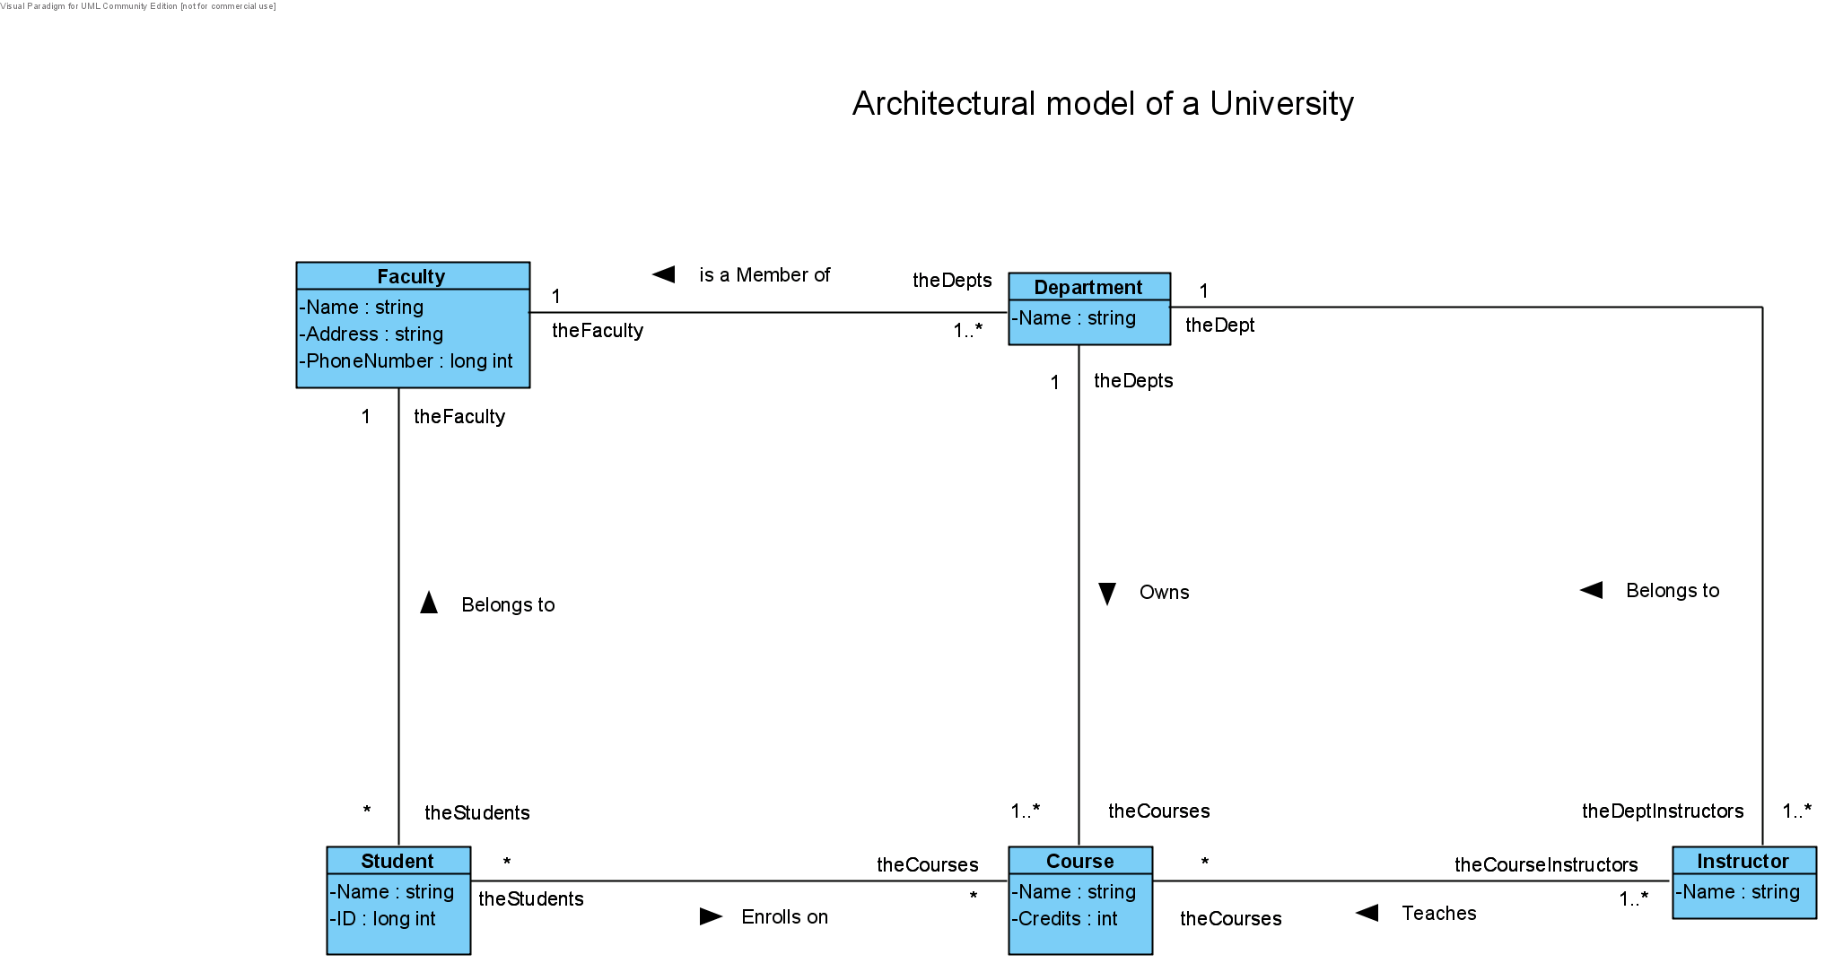
See if you can interpret this Class Diagram representing an architectural model of a University. What objects could be created out of these classes and what relationships would they have to each other.

Slide 27
class Faculty {
string Name, Address ; // member variables
long int PhoneNumber ;
public: // associations
list<Dept *> theDepts ; // list of Dept pointers and Student Pointers
list<Student *> theStudents ;
// function to make and break the dynamically changeable associations on the class diagram for a faculty object
void AddDept( Dept *thisDept);
void AddStudent( Student *thisStudent);
void DelDept( Dept *thisDept);
void DelStudent( Student *thisStudent);
// usual constructor and destructor
Faculty(string &theName, string &theAddress, long int thePhoneNumber) ;
~Faculty() ;
// accessor and Mutator Functions
void setName(string &theName) ;
string getName() ; // etc for all member variables
// functions to get pointers to list of objects at end of associations
list<Dept *> *getDepts() { return &theDepts ; }
list<Student *> *getStudents() { return &theStudents ; }
} ;

Slide 28
Exercise: The diagram two slides previous only captures a set of theoretical courses, students, depts etc that might exist in any University.
It says nothing about what courses, depts, students actually exist on any given day within one particular university.
Using the diagram on the previous, create an object diagram to show what students, depts, courses, faculties, instructors exist in you university at “run time”etc.
That is, create a snap shot of a “real” system existing at run time.

Slide 29
Aggregation and Composition Relationships

Slide 30
Aggregation and Composition Relationships
Sometimes the links between objects in a system are so strong that a simple association does not seem sufficient to capture the essence of that relationship.
For example we know from simple observation that some objects ‘contain’ or ‘own’ other objects.
Thought of the other way around, we think of some objects as being ‘part of’ or ‘belonging to’ others. For example
  A CPU is part of a Computer (the computer owns the CPU).
  A Motherboard owns the PCi slots (the slots belong to the motherboard).
  A Gearbox and Engine are part of a Car (the car owns gearbox/engine etc.)
  A Walls, Windows, Chairs, Doors and Projector are part of the room.
  A Room is part of a building.
  A Building is part of the campus etc.
The concept of one object being part of another is strongly engrained into real life and object oriented programming.
We might wish to capture this part/owning relationship on a class diagram using the concepts of aggregation or composition.

Slide 31
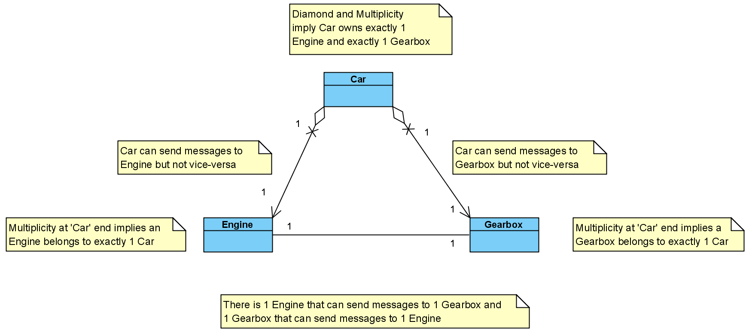
Aggregation and Composition are more specialized forms of association implying increasing levels of ownership and responsibility and are used to model ‘Has-a’ relationships.
The example below demonstrates how to model aggregation using an open diamond at the owning end of the association.
In this example, we capture the idea that a ‘car has an engine’ and the ‘car has a gearbox’.
Ownership does not affect in any way, the concept of message passing. The ‘owner’ can send messages to the ‘part’ or vice-versa if required. In the specific example below, we show uni-directional messaging, i.e. a car can send messages to its engine/gearbox but not vice-versa.
Aggregation Diamond drawn at the end of the owner e.g. Car has 1 Engine and 1 Gearbox.

Slide 32
What are the semantics (meaning) implied by Aggregation?
Aggregation implies ownership of the part is transitory.
That is, ‘Parts’ may be detached from their ‘owner’ and given to another ‘owner’ , like a broken bulb being removed from a lamp.
Aggregation implies that its ‘parts’ can be shared, i.e. two owners can share the same part and communicate with it.
The ‘owner’ is not responsible for creating or destroying its parts – they may have separate lives, e.g. create a bulb, then create a lamp and finally add the bulb to the lamp at run time. In reverse, detach the bulb from the lamp, then destroy bulbs and/or lamps independently.
The above thus implies that some kind of ‘getPart()’, ‘addPart()’ or ‘ExchangePart()’ functions must exist within the owner to make/break the ownership links (like we did with the CLamp class).

Slide 33
What does Aggregation mean from a code perspective?
Aggregation actually implies the same code as an association, i.e. a pointer in the owner class pointing to the part that it owns. For example
  class Car
  {
Engine *E1 ; // pointers to the ‘parts’ owned by car
Gearbox *G1;
. . .
Engine *GetEngine() { return E1 ; E1 = NULL; } // allows for retrieval of the engine
Gearbox *GetGearbox() { return G1 ; G1 = NULL; } // allows for retrieval of the gearbox
void AddEngine (Engine *theNewEngine ) { // permits ownership of an engine
E1 = theNewEngine ; // point to new engine
}
. . .
Engine *ExchangeEngine (Engine *theNewEngine ) { // swap an engine for a new one
Engine *temp = E1 ; // save pointer to current engine
E1 = theNewEngine; // point car to it’s new engine
return temp; // return pointer to old engine for
} // re-use or destruction later
};
In this respect aggregation has been described as a modelling placebo that is, “Using it makes you feel good” but doesn’t alter the fact that aggregation is still implemented in code exactly like an association, nothing different.
The Car destructor would not delete the Engine and Gearbox objects. Similarly, GetEngine() and GetGearbox() functions would be created to detach the owned objects and return them back to the caller (as above).

Slide 34
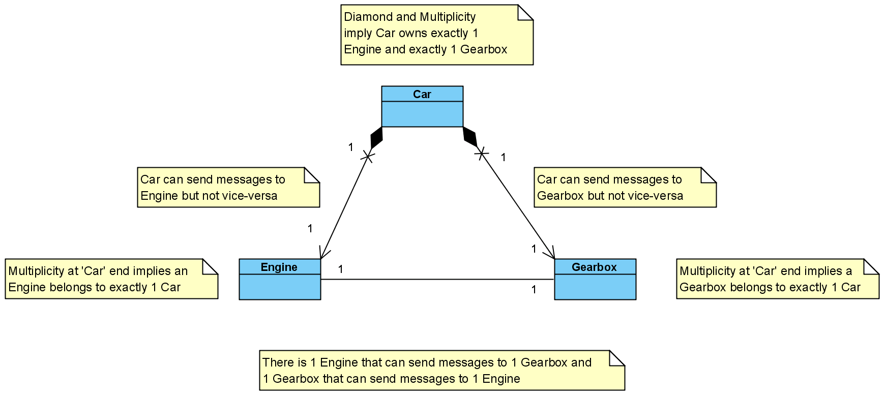
Composition
Composition is a stronger form of aggregation where the life times of the owner and part(s) are the same, implying that the ‘owner’ is responsible for the creation and destruction of the ‘parts’ that it owns.
An example of composition is shown below with a filled diamond.
Composition Diamond drawn at the end of the owner e.g. Car has an Engine.

Slide 35
What are the Semantics (meaning) implied by Composition?
Composition implies that ownership of the parts is fixed.
Parts’ cannot be detached from their ‘owner’ and/or given to another ‘owner’
Composition implies that the owner creates and destroys the parts that it owns.
Composition implies that the ‘part’ is also hidden inside the owner and is not directly visible or accessible to other objects in the system other than the owner. Thus the part (or any pointer to it) is declared ‘private’ in the owner class.
The owner must thus manipulate the ‘part’ (see code sample next) on behalf of other users,
Composition implies that its ‘parts’ cannot be shared, they below to one owner.
Question: Given these semantics, is aggregation or composition the best ownership relationship between a Car and its Engine/Gearbox?
Question: Would it matter if we captured the Engine/Gearbox relationships using either association, aggregation or composition – would it work?

Slide 36
What does Composition mean from a code perspective?
Composition implies that Engine and Gearbox are created and destroyed by the Car as part of the constructor and destructor. There should be no way to gain access to the part objects from outside the owning class (as this might imply sharing, detachment, creation/destruction etc.)
  class Car
  {
  private:
Engine *E1; // ‘private pointers means parts are inaccessible to outside world
Gearbox *G1; // there should be no functions to return those pointers
public:
Car(…..) { // constructor takes optional args to initialise Eng/Gearbox
E1 = new Engine(…..) ;
G1 = new Gearbox(…..) ;
}
~Car() {
delete E1;
delete G1 ;
}
// no functions to permit the returning of a pointer to the engine or gearbox allowed
// no function to add or swap the engine or gearbox allowed as this implies sharing of the part
// all functions to manipulate Engine and Gearbox from outside the Car class
// and must go through the car class e.g.
void ChangeGear( int newGear) { G1 -> ChangeGear( newGear); }
void StartEngine() { E1 -> Start(); }
void StopEngine() { E1 ->Stop(); }
} ;
Owner responsible for creation of parts
Owner responsible for destruction of its parts
Access to Parts (gearbox) is via the Car (Owner ) only

Slide 37
Give me a rock solid example of Composition and Aggregation
A University owns various departments (e.g., chemistry), and each department has a number of Professors. The departments cannot exist without the University, thus if the university closes, the departments can no longer survive and must close also. However the Professors in those departments will continue to exist even if their dept and University closes.
Therefore, a University can be thought of as a composition of departments, whereas departments could be thought of as an aggregation of Professors.
Aggregation, implies possible sharing of the parts, thus an aggregation of Professors means that a professor could belong to more than one departments, but because a University is a composition of departments, each dept cannot belong to more than one university.
Taken from https://en.wikipedia.org/wiki/Object_composition

Slide 38
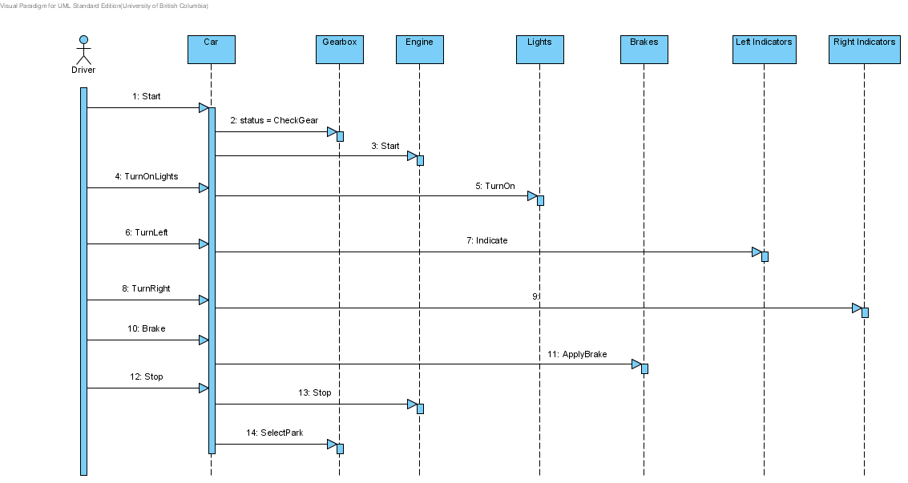
Identifying Potential Aggregation/Composition Relationships
Sometimes the decision to encapsulate one object inside another is something that just ‘feels right’ and can be somewhat arbitrary.
However, a sequence diagram can sometimes give us the strongest clues. In the example S.Diagram below, we see a driver interacting with a car, which in turn sends messages to gearbox, engine etc.
The fact that the driver has to go through the car object to control the engine, gearbox etc. and does not have direct access to those objects gives the strongest hint that perhaps the engine, gearbox etc. should be made part of the car, i.e. encapsulated within it.
Whether Composition or Aggregation is chosen depends upon how tightly the whole (car) and parts (engine, gearbox etc.) should be bound together, their relatives lifetimes and how they are manipulated from outside.

Slide 39
Generalisation Relationships

Slide 40
Generalisation
Generalisation is fundamentally a relationship between classes (rather than objects), because it defines a set of common attributes, behaviours, and interfaces for all derived classes.
In UML, this is how we create ‘Kind-of’ relationships which implies two things:
  Inheritance
  Substitutability.
Inheritance means that derived or child classes inherit all the member variables and functions of their base or parent class. In fact they may add their own or even override/modify the ones they inherit.
The concept of substitutability means that a derived or child class can be used or substituted anywhere in a program where a base or parent class could have been used.
The UML provides a simple notation for expressing inheritance as shown in the example overleaf.

Slide 41
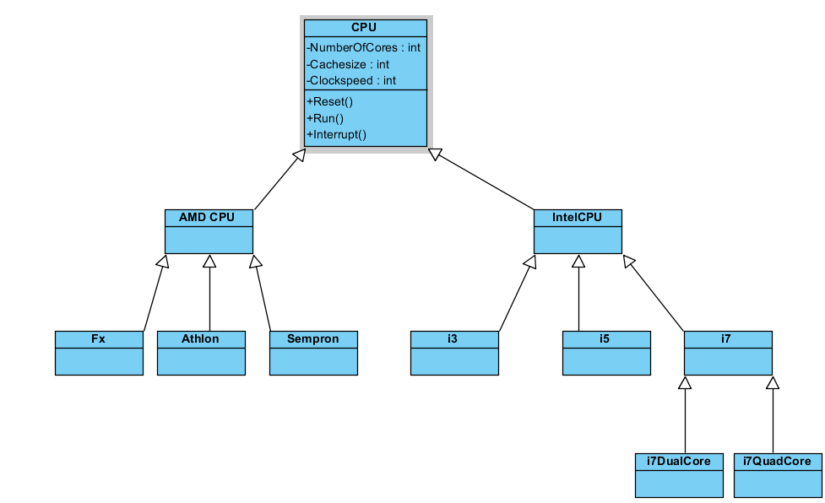
Generalisation (inheritance). This means that ‘AMD CPU’ is a ‘kind-of’ CPU. It also means that ‘AMD CPU’ is a substitute for a CPU
Generalisation (inheritance). This means that ‘Intel CPU’ is a ‘kind-of’ CPU. It also means that ‘Intel CPU’ is a substitute for a CPU
‘Fx, Athlon and Sempron are ‘kinds-of’ AMD CPU. It also means that ‘each’ is a substitute for an ‘AMD CPU’ (but not an Intel CPU) and is also a substitute for a ‘CPU’
Through the process of inheritance, all classes lower in the hierarchy inherit the member functions and variables of all classes higher up, and can add or redefine operations thus an Fx can perform Reset(), Run() and Interrupt() or could redefine those operations to work in different ways to the base class CPU
I3, i5 and i7 are ‘kinds-of’ Intel CPU. It also means that and ‘i3’ is a substitute for an ‘Intel CPU’ (but not an AMD CPU) and is also a substitute for a ‘CPU’
Through the process of inheritance, all classes lower in the hierarchy inherit the member functions and variables of all classes higher up, and can add or redefine operations thus ai3 can perform Reset(), Run() and Interrupt() or could redefine those operations to work in different ways to the base class CPU

Slide 42
What does Inheritance mean in terms of Code?
class IntelCPU : public CPU {
public:
IntelCPU(…..) : CPU(….) { }
// new or overridden member functions and/or variables
} ;
class AMDCPU : public CPU {
public:
AMDCPU(…..) : CPU(….) { }
// new or overridden member functions and/or variables
} ;
class i3: public IntelCPU {
public:
i3(…..) : IntelCPU(….) { }
// new or overridden member functions and/or variables
} ;
C++ code stating that ‘IntelCPU’ is derived from ‘CPU’, the ‘public’ means that the interfaces of the base class ‘CPU’ are available to the user of an ‘IntelCPU’
Derived class constructor calls base class constructor which is responsible for initialising base class variables

Slide 43
Now we can create code like this
int main()
{
CPU *theCPU = new i7QuadCore(…) ;
theCPU ->reset() ;
theCPU ->run() ;
} ;
This is useful in things like linked lists, where for example, the list contains pointers to a base class. Now we could add items to the list which are either direct instances of the base class, or instances of any class derived from that base class. The compiler will do the necessary checking.
For example with a list designed to store “IntelCPUs” we could add items which are i3, i5 or i7 (since they are interchangeable with and thus substitutable for any kind of IntelCPU) etc. but NOT instances of a base class CPU or any kind of AMD CPU.
A base class pointer can point to a derived class object because the derived class object is a valid substitute for the base class, that is, it can do everything a base class object can do

Slide 44
Problem:
Identify as many components as you can that go to make up a desktop PC and identify the relationships between them and where relevant their multiplicities, don’t forget to include thinks like different kinds of CPU, cases, disk drives motherboards etc.
Now draw a class diagram to represent them and show how those relationships would be mapped to code (ignore member variables and functions – just capture the code to represent the relationships.

Slide 45
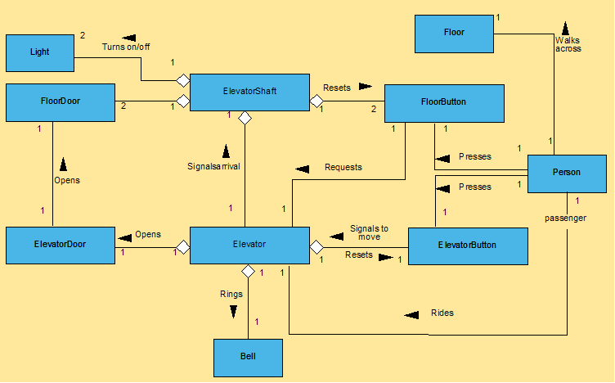
Here’s a example class diagram for an elevator. See if you can interpret it and explain it to another colleague.
Now see if you could create the classes that represent the relationships and multiplicities. Ignore member functions and attributes.

Slide 46
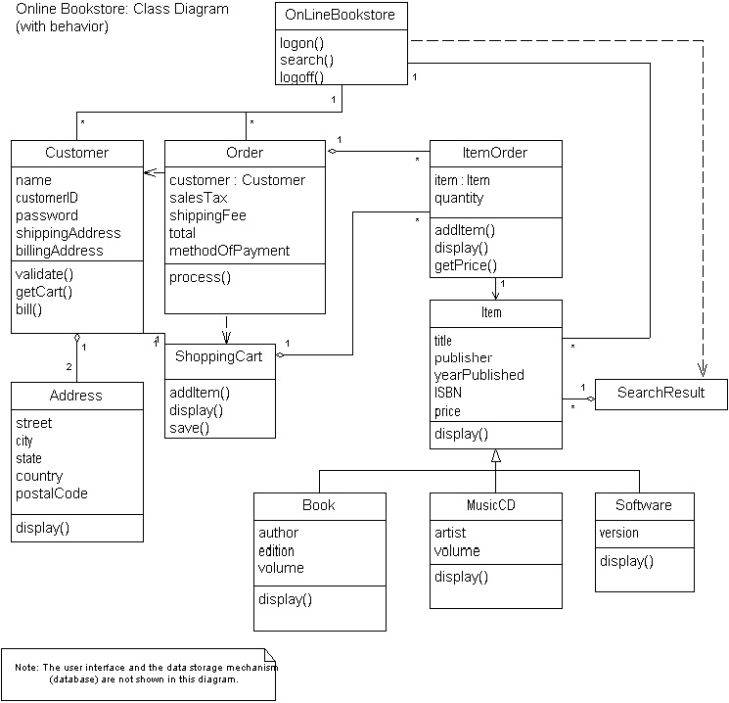
See if you can do the same thing with this “on line bookstore” class diagram. This time add the member functions and attributes

